Slide 1
Hydrology
G205 course

Slide 2
Hydrology is the science that treats the waters of the earth, their occurrence, circulation and distribution, their chemical and physical properties, and their reaction with their environment, including their relation to living things.
The domain of hydrology embraces the full life history of water on the earth

Slide 3
Estimation of water resource
Hydrology
deals with
The study of processes such as precipitation, evapotranspiration, runoff and their interaction
The study of problems such as floods and droughts and strategies to combat them

Slide 4
Water use – water withdrawal and in stream uses
What hydrologist do
Water control – flood and drought mitigation
Pollution control – point and nonpoint sources

Slide 5
Atmospheric process: cloud condensation and precipitation
Surface process – snow accumulation, overland flow, river flow, lake storage
Hydrology study the following physical processes
Subsurface processes –Infiltration, soil – water storage, groundwater flow
Interfacial processes – evaporation, transpiration, sediment-water exchange

Slide 6
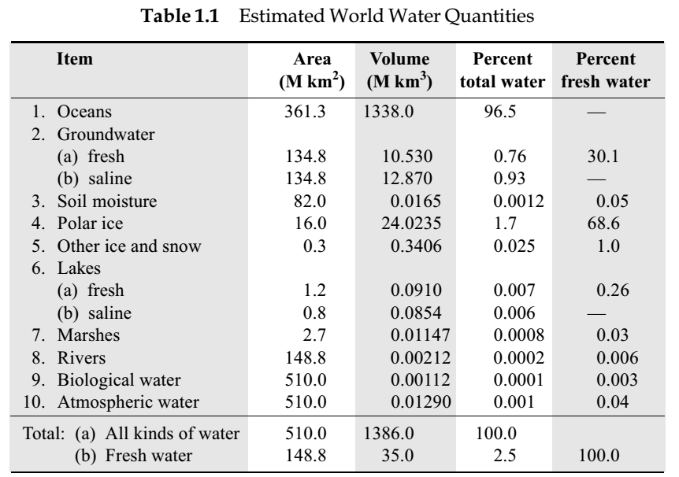
Distribution of water in the globe

Slide 7
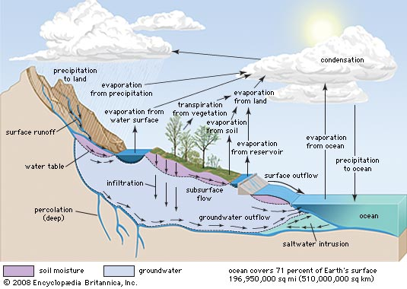
Hydrological Cycle

Slide 8
Hydrological Cycle
Hydrological cycle is the cyclic movement of water containing basic continuous processes like evaporation, precipitation and runoff.
It is a continuous cycle which starts with evaporation from the water bodies such as oceans.

Slide 9
Study of hydrological cycle is essential for
sustainable agriculture (foods for the growing population)
environmental protection and management
water resources development and management
prevention and control of natural disasters
mitigation of the negative impacts of climatic change

Slide 10
Study of hydrological cycle is essential for
sustainable agriculture (foods for the growing population)
environmental protection and management
water resources development and management
prevention and control of natural disasters
mitigation of the negative impacts of climatic change

Slide 11
Components of hydrological cycle
Evaporation
it is the conversion of natural liquids like water into gaseous form like air.
Condensation
It is the conversion of a vapor or gas to a liquid
Precipitation
It is the fall of moisture from atmosphere to the earth’s surface in any form. Example: rain, hail, snow, sleet, glaze, drizzle, snow flakes
Transpiration
it is the evaporation taking place from any plant or greenery. Example, water droplet on a leaf getting evaporated into atmosphere

Slide 12
Evapotranspiration
it is the combination of evaporation and transpiration
Infiltration
it is the process of filtration of water to the inner layers of soil based on its structure and nature. Infiltration in soils like sand, gravel and coarser material is more and for finer soil particles like clay and silt, infiltration is less.
Runoff
it is the water flowing over the land making its way towards rivers, lakes, oceans etc. as surface or subsurface flow
Surface runoff: it is the running water over the land and which ultimately discharge water to the sea
Subsurface runoff: The water getting infiltrated into pervious soil mass, making its way towards rivers and lakes can be termed as subsurface run off

Slide 13
Depression storage
it is the part of precipitation required to fill depression zones of land
Interception
Part of precipitation required to wet the surface of soil, buildings and all pervious surfaces

Slide 14
Process of Hydrological Cycle
Process of hydrological cycle starts with oceans. Water in oceans, gets evaporated due to heat energy provided by solar radiation and forms water vapor. This water vapor moves upwards to higher altitudes forming clouds. Most of the clouds condense and precipitate in any form like rain, hail, snow, sleet. And a part of clouds is driven to land by winds. Precipitation, while falling to the ground, some part of it evaporates back to atmosphere.
Portion of water that reaches the ground, enters the earth’s surface infiltrating various strata of soil and enhancing the moisture content as well as water table. Vegetation sends a portion of water from earth’s surface back to atmosphere through the process of transpiration. Once water percolates and infiltrates the earth’s surface, runoff is formed over the land, flowing through the contours of land heading towards river and lakes and finally joins into oceans after many years. Some amount of water is retained as depression storage.

Slide 15
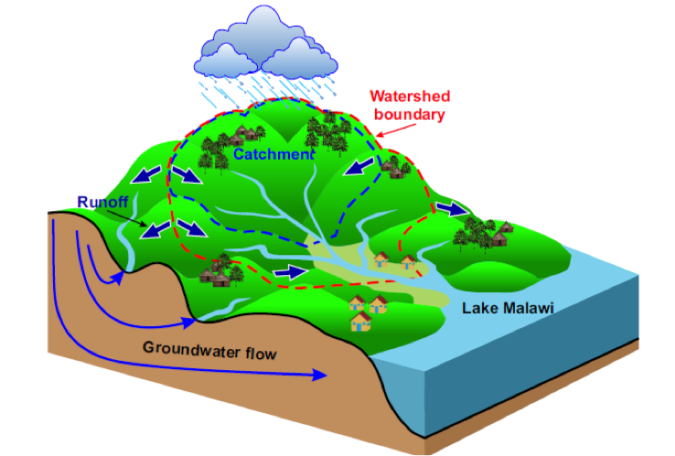
Watershed, Drainage Basin, and Catchment area
An area of land that catches rain and other types of precipitation and then directs it to neighboring bodies of water

Slide 16
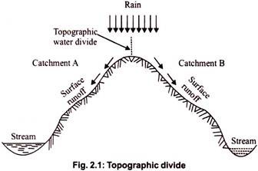
Watershed divide
a line dividing land whose drainage flows toward the given
stream from land whose drainage flows away from that stream.

Slide 17
Water balance equation for a catchment area
In hydrology, a water balance equation can be used to describe the flow of water in and out of a system.
The hydrological equation is simply the statement of the low of conservation of matter and it given by:
$$I −O= ∆S$$
CHANGE OF STORAGE
INPUT
OUTPUT
This equation states that during a given period, the total inflow into a given area must equal the total outflow from the area plus the change in storage.

Slide 18
Water balance equation for a catchment area
Expression for the water budget of a catchment for a time interval Δt is written as
P – R – G – E – T = ΔS
Change of storage
Precipitation
Transpiration
Evaporation
Surface runoff
All terms in the equation have the dimensions of volume.
All these terms can be expressed as depth over the catchment area (cm for example).
Groundwater outflow

Slide 19
Solved example
A lake had a water surface elevation of 103.200 m above datum at the beginning of a certain month. In that month the lake received an average inflow of 6.0 m³/s from surface runoff sources. In the same period the outflow from the lake had an average value of 6.5 m³/s. further, in that month, the lake received a rainfall of 145 mm and the evaporation from the lake surface was estimated as 6.10 cm. write the water budget equation for the lake and calculate the surface elevation of the lake at the end of the month. The average lake surface area can be taken as 5000 ha. Assume that there is no contribution to or from the groundwater storage.

Slide 20
Solved example
P = 145 mm
E = 6.10 cm
Q_{in} = 6 m³/s
Q_{out} = 6.5 m³/s
Lake area = 5 000 ha
103.2 m
datum

Slide 21
Solved example
In a time period Δt the water budget for the lake can be written as
Input volume – output volume = change in storage
precipitation
evaporation
Average inflow rate
Average outflow rate
Change in lake storage volume
Surface area of the lake

Slide 22
Water budget equation
SOLUTION
Here Δt = 1 month How to convert to sec.
It is a simple task, lets have a look
= 2.592 × 10⁶ s = 2.592 Ms

Slide 23
Solved example
Inflow volume = = 6.0 × 2.592 = 15.552 Mm³
Outflow volume = = 6.5 × 2.592 = 16.848 Mm³
Input due to precipitation = P A = 7.25 Mm³
Convert ha to m2 (1 hectare = 10000 square meter)
Convert mm to m (1 millimeter = 0.001 meter)

Slide 24
Solved example
Outflow due to evaporation = EA = 3.05 Mm³
Hence ΔS = 15.552 + 7.25 – 16.848 – 3.05 = 20.904 Mm³
Change in elevation
Δz = Δs/A = 0.058
Net water surface elevation at the end of the month = 103.200 + 0.058
= 103.258 m

Slide 25
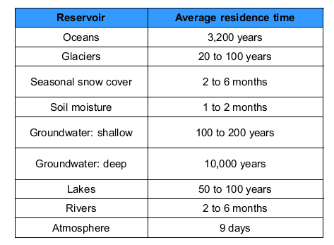
Residence Times
The average time a water molecule will spend in that reservoir and it is a measure of the average age of the water in that reservoir

